Slide 1
A Simple High-Performance Rolling Horizon Evolutionary Algorithm IGGI AI-Based Game Design
Simon Lucas
Game AI Research Group
Queen Mary University of London
Notes:
Hi, I’m Simon Lucas, welcome to my short video about general AI with statistical forward planning algorithms

Slide 2
Outline
Context
A simple evolutionary algorithm
The basic idea of Rolling Horizon Evolutionary Algorithms
A particular setup and parameterization
Implementation in a Game Playing Agent
Optimising performance

Slide 3
SFP is NOT new The algorithms:
Monte Carlo Search (Scrabble – Maven, 1998)
Monte Carlo Tree Search (Go, 2006)
Rolling Horizon Evolution
Video Games, 2013 (our group)
Recent developments have led to leaps in performance
Notes:
Monte Carlo Search made it’s name in Scrabble twenty years ago, and Monte Carlo Tree Search in Go more than 10 years ago, but I’m going to talk about roiling horizon evolution which is especially simple and good for video games

Slide 4
All SFP Algorithms:
Rely on fast forward model:
Aim to run this around 2,000 ticks per decision
F(s,a)-> s’

Slide 5
What you need to implement: (repeated from intro)
public interface AbstractGameState { AbstractGameState copy(); AbstractGameState next(int[] actions); int nActions(); double getScore(); boolean isTerminal(); }
Notes:
Here’s what you need to do to add this magic AI to your game or system: the ones to be careful with are copy and next

Slide 6
Basic Evolutionary Algorithms we’ll see some code in a minute
Initialise (pick random points in space)
Evaluate (not part of the algorithm, but must be done)
Select Best
Vary them and go back to Evaluate if budget permits
Terminology:
We use FITNESS usually to mean a numerical score given to how good a solution is
All called on OBJECTIVE function
This is usually a property of an individual solution
Aim may be to minimise of maximise this
For multi-player games may be computed with respect to OTHER solutions in a population of possible solutions – this is called Co-Evolution

Slide 7
My Favourite Evolutionary Algorithm Random Mutation Hill-Climber (RHMC)
Ultra-simple
Performance very good across a range of problems
Prone to get stuck in local optima
So run with random restarts or allow Large Mutations
AKA: (1+1) ES (continuous) or (1+1) EA (discrete)

Slide 8
The Algorithm (1+1 EA)
Make a single random solution – call it bestYet
Repeat until termination
mutatedCopy := copyAndMutate(bestYet)
If (mutatedCopy is better than or equal to bestYet)
bestYet := mutatedCopy
Terminate if bestYet is good enough
OR we’ve run out of time
Question: where is the fitness evaluation done?
Notes:
Question, why is it important to say “better than or equal to?”

Slide 9
Next we’ll see a complete (1+1) EA Solving OneMax. -Code is in Kotlin (concise)
One-Max: the fitness is defined as the sum of values in a bit vector (where each value is either zero or 1)
E.g. if to calculate fitness of current solution: current.sum()
Perhaps the simplest possible discrete optimisation problem to solve
No local optima
No “epistatis”
i.e. each dimension of the vector contributes to the overall fitness of the vector independently of all other dimensions

Slide 10
What use is OneMax?
Provides a simple test
Think of it like an Upper Bound on how well an EA could perform
But appreciate two things:
For Game AI, the Fitness Landscape is DYNAMIC: always changing
We’re usually NOT AIMING FOR OPTIMAL

Slide 11
class SimpleOneMax(val mutationRate: Double = 0.05, val n: Int = 20) { var current = IntArray(n) { i -> Random.nextInt(2) } fun run(nEvals: Int) { for (i in 0 until nEvals) { val mut = mutate(current) // note: would normally test ">=" if (mut.sum() > current.sum()) { current = mut println("$i\t ${current.sum()}\t ${Arrays.toString(current)}") if (mut.sum() == n) { println("Optimum after $i iterations") return } } } } fun mutate(x: IntArray): IntArray { val mut = IntArray(n) for (i in 0 until n) mut[i] = if (Random.nextDouble() < mutationRate) 1 - x[i] else x[i] return mut } }
Notes:
Question: how many fitness evaluations will be made?

Slide 12
Running SimpleOneMax
fun main() { val oneMax = SimpleOneMax(mutationRate = 0.2)
// run for 100 iterations oneMax.run(100) }

Slide 13
Sample Output – is this in line with what you expected?
3 12 [0, 1, 1, 0, 1, 0, 1, 1, 1, 1, 0, 0, 1, 0, 1, 1, 1, 0, 0, 1]
4 13 [0, 1, 1, 1, 1, 0, 1, 1, 1, 1, 0, 0, 1, 0, 1, 1, 1, 0, 0, 1]
6 16 [1, 1, 1, 1, 1, 0, 1, 1, 1, 1, 0, 1, 1, 0, 1, 1, 1, 0, 1, 1]
12 17 [1, 1, 0, 1, 1, 1, 1, 1, 1, 1, 1, 1, 1, 1, 1, 1, 1, 0, 1, 0]
84 18 [1, 0, 0, 1, 1, 1, 1, 1, 1, 1, 1, 1, 1, 1, 1, 1, 1, 1, 1, 1]

Slide 14
Lab Exercise [Suggest working in small groups or discussing with module staff]
Using the SimpleOneMax code, estimate how “optimal” SimpleEvoAgent would be if playing in a PlanetWars size search space, but with a OneMax fitness function
The first part of the exercise is to understand the task!

Slide 15
We’ve covered the necessary evolutionary algorithm
Now let’s build a SimpleEvoAgent

Slide 16
Interfacing SimpleEvoAgent to game: Simple Player Interface
public interface SimplePlayerInterface { int getAction(AbstractGameState gameState, int playerId); SimplePlayerInterface reset(); }

Slide 17
SimpleEvoAgent
We’ll look now at the main methods in this class
This is the agent you’ve seen demonstrated playing Asteroids, PlanetWars and CaveSwing
Using the same or very similar default settings

Slide 18
Example settings (sequence length can be game-dependent) (expectedMutations: often around 10% of seqLen)
public boolean flipAtLeastOneValue = true; public double expectedMutations = 20; public int sequenceLength = 200; public int nEvals = 20; public boolean useShiftBuffer = true;

Slide 19
public int[] getActions(AbstractGameState gameState, int playerId) { if (useShiftBuffer && solution != null) { solution = shiftLeftAndRandomAppend(solution, gameState.nActions()); } else { System.out.println("New random solution with nActions = " + gameState.nActions()); solution = randomPoint(gameState.nActions()); } for (int i = 0; i < nEvals; i++) { // evaluate the current one int[] mut = mutate(solution, expectedMutations, gameState.nActions()); double curScore = evalSeq(gameState.copy(), solution, playerId); double mutScore = evalSeq(gameState.copy(), mut, playerId); if (mutScore >= curScore) { solution = mut; } } int[] tmp = solution; // nullify if not using a shift buffer if (!useShiftBuffer) solution = null; return tmp; }

Slide 20
Make a random solution (assumes same number of actions available at each step)
private int[] randomPoint(int nValues) { int[] p = new int[sequenceLength]; for (int i=0; i<p.length; i++) { p[i] = random.nextInt(nValues); } return p; }

Slide 21
Next we have a random mutation
How does this differ from the mutation operator earlier in the slides?
More importantly, why does it differ!!!

Slide 22
private int[] mutate(int[] v, double expectedMutations, int nActions) { int n = v.length; int[] x = new int[n]; // pointwise probability of additional mutations double mutProb = expectedMutations / n; // choose element of vector to mutate int ix = random.nextInt(n); if (!flipAtLeastOneValue) { // setting this to -1 means it will never match the first clause in the if statement in the loop // leaving it at the randomly chosen value ensures that at least one bit (or more generally value) is always flipped ix = -1; } // copy all the values faithfully apart from the chosen ones for (int i = 0; i < n; i++) { if (i == ix || random.nextDouble() < mutProb) { x[i] = mutateValue(v[i], nActions); } else { x[i] = v[i]; } } return x; }

Slide 23
Mutate a single value (gene)
private int mutateValue(int cur, int nPossible) { // the range is nPossible-1, since we // selecting the current value is not allowed // therefore we add 1 if the randomly chosen // value is greater than or equal to the current value if (nPossible <= 1) return cur; int rx = random.nextInt(nPossible - 1); return rx >= cur ? rx + 1 : rx; }

Slide 24
This implements the Shift Buffer
private int[] shiftLeftAndRandomAppend(int[] v, int nActions) { int[] p = new int[v.length]; for (int i = 0; i < p.length - 1; i++) { p[i] = v[i + 1]; } p[p.length - 1] = random.nextInt(nActions); return p; }

Slide 25
This evaluates a sequence
private double evalSeqNoDiscount(AbstractGameState gameState, int[] seq, int playerId) { double current = gameState.getScore(); int[] actions = new int[2]; for (int action : seq) { actions[playerId] = action; actions[1 - playerId] = opponent.getAction(gameState, 1 - playerId); gameState = gameState.next(actions); } double delta = gameState.getScore() - current; if (playerId == 0) return delta; else return -delta; }

Slide 26
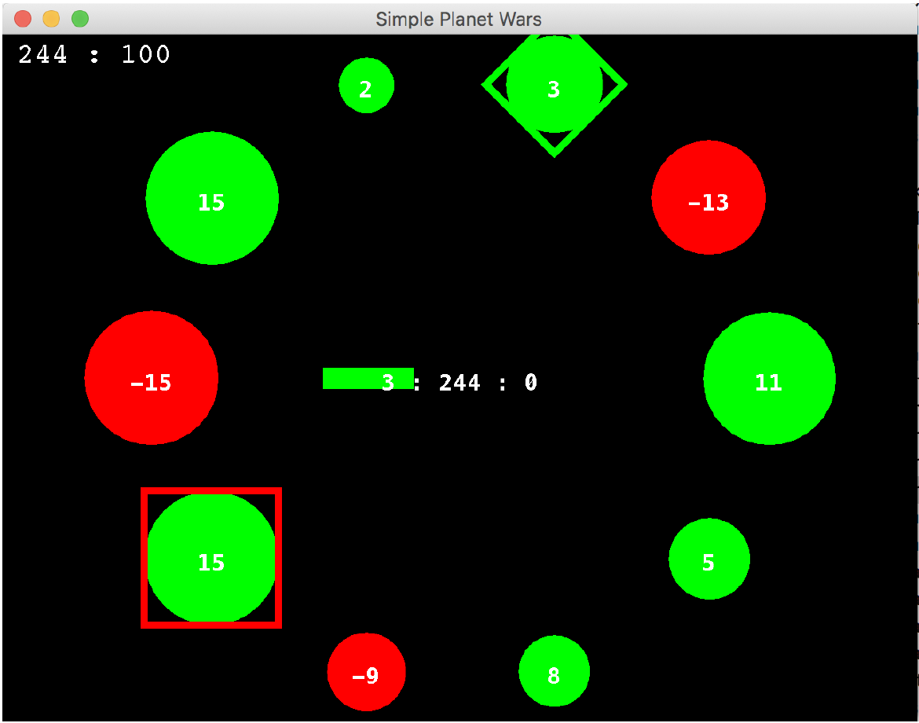
Test Game: Simplified Planet Wars
Random initial states (ownership, planet sizes and number of ships)
Each disc is a planet showing the number of ships and ownership (+ve green)
Planets grow ships are rate proportional to their size
Ships can only be transferred via each player’s buffer and their planet of focus
Aim: wipe out opponent, or have most ships at time limit
Win/loss game (player is only rewarded for winning, margin does not matter)
Constant speed irrespective of number of planets
Notes:
Check out what this means!!!

Slide 27
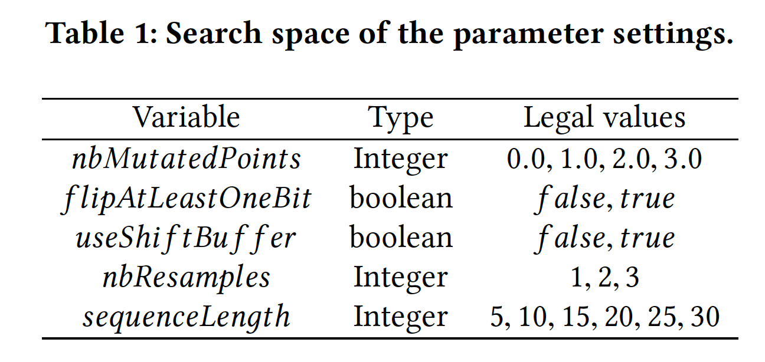
Tuning RHEA with the NTBEA: The Parameter Space

Slide 28
Observing the Rollout Scores
The following is the exact same version of Simplified PlanetWars
Only differs in whether transit ships are included in the score

Slide 29
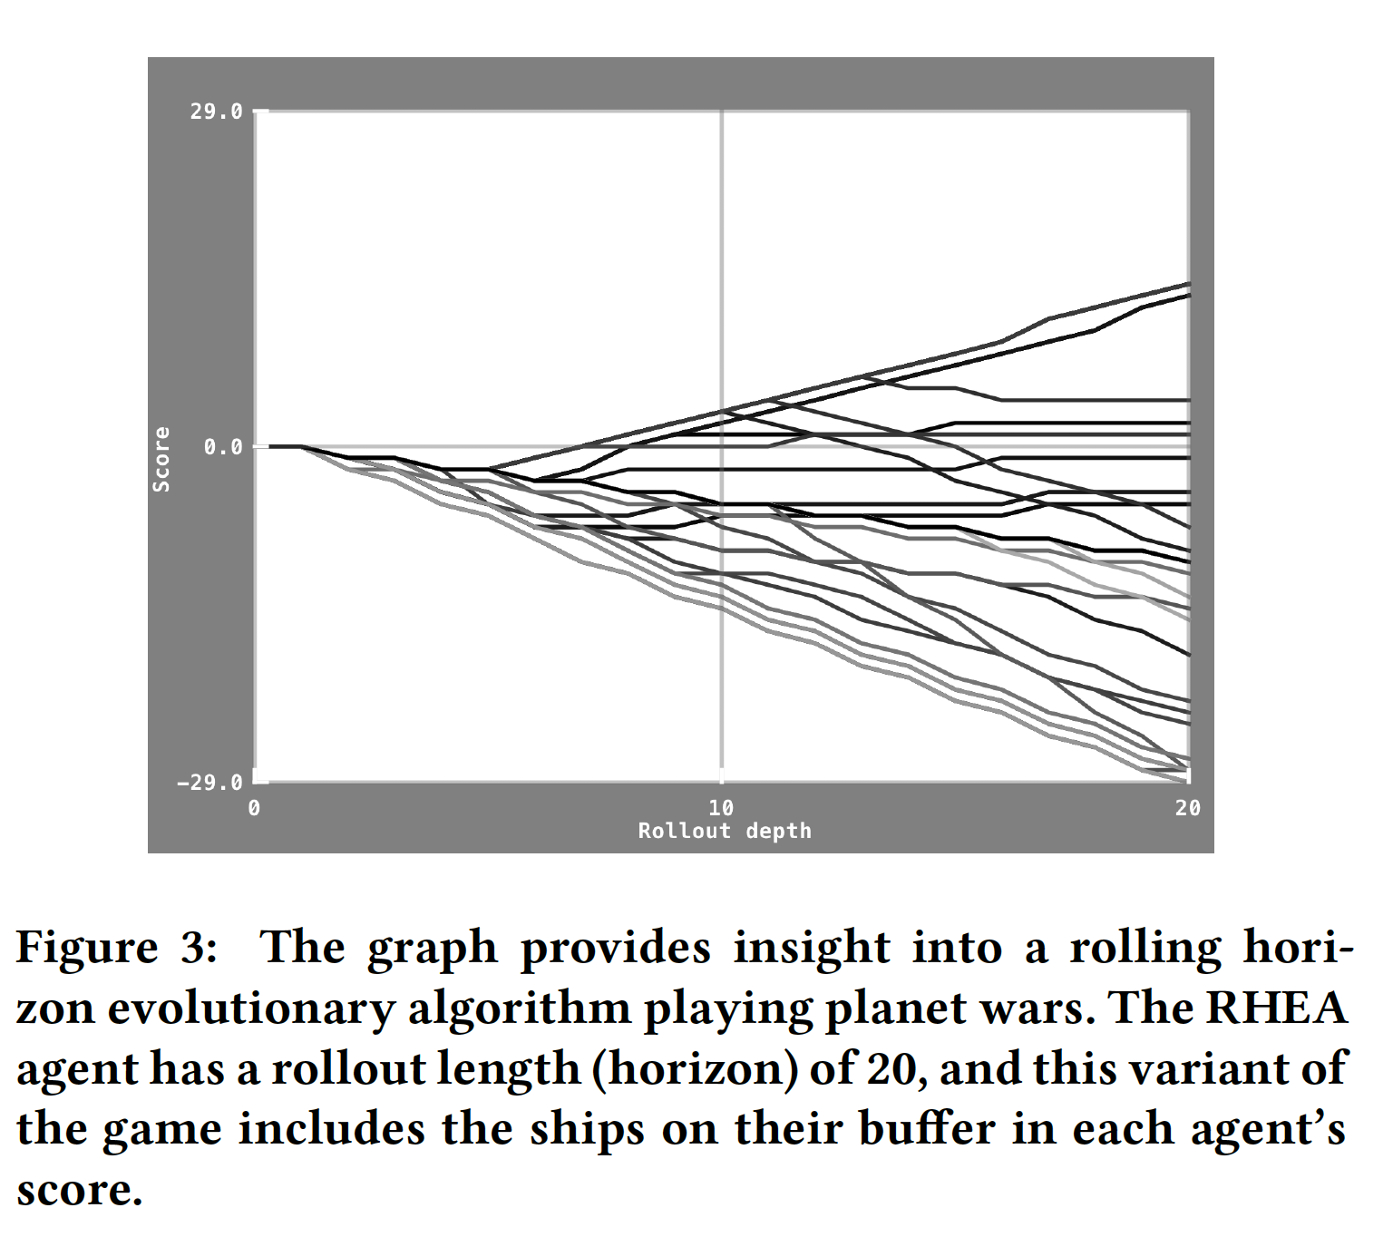
Plotting game score versus position in rollout (action sequence) – buffers included

Slide 30
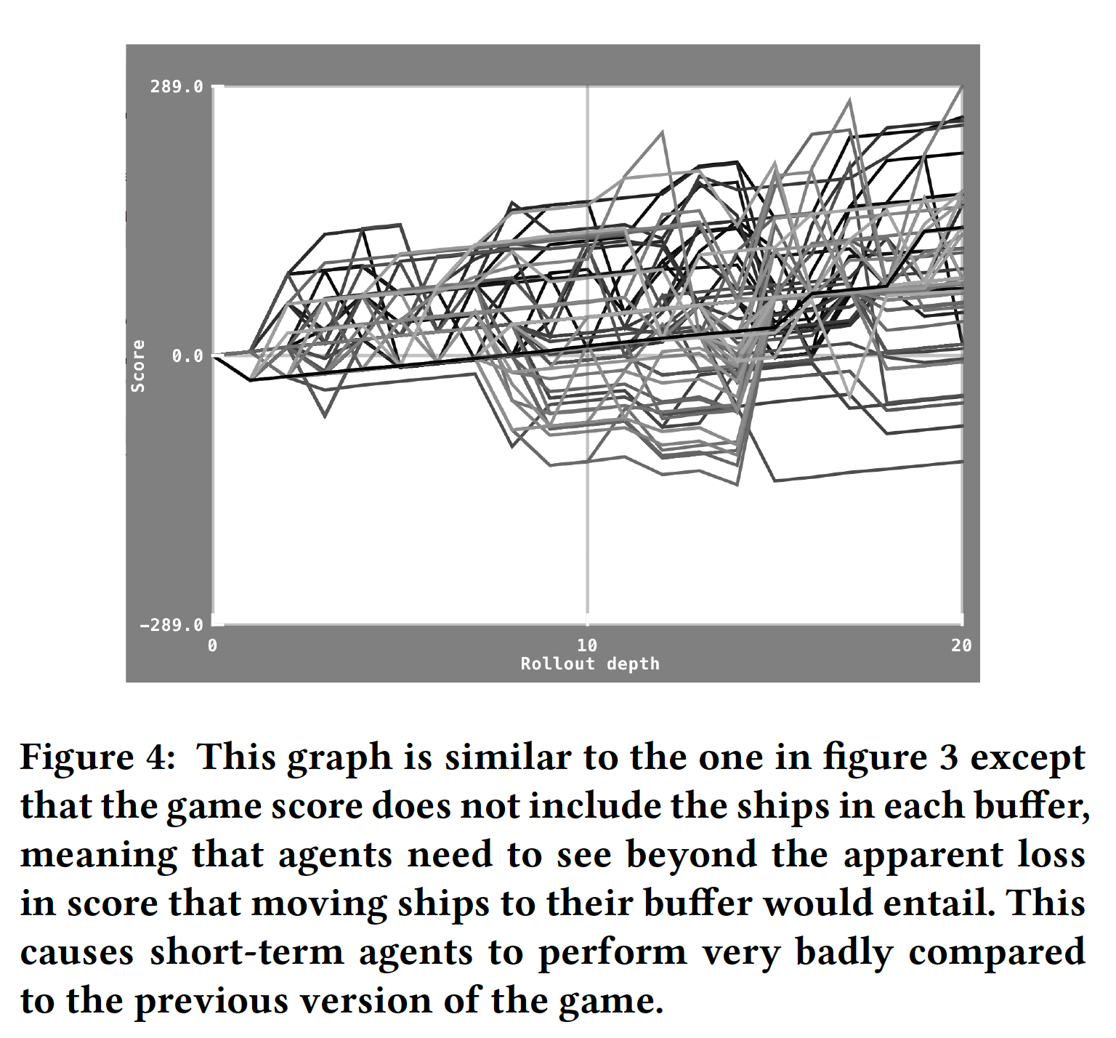
Plotting game score versus position in rollout (action sequence) – buffers not included

Slide 31
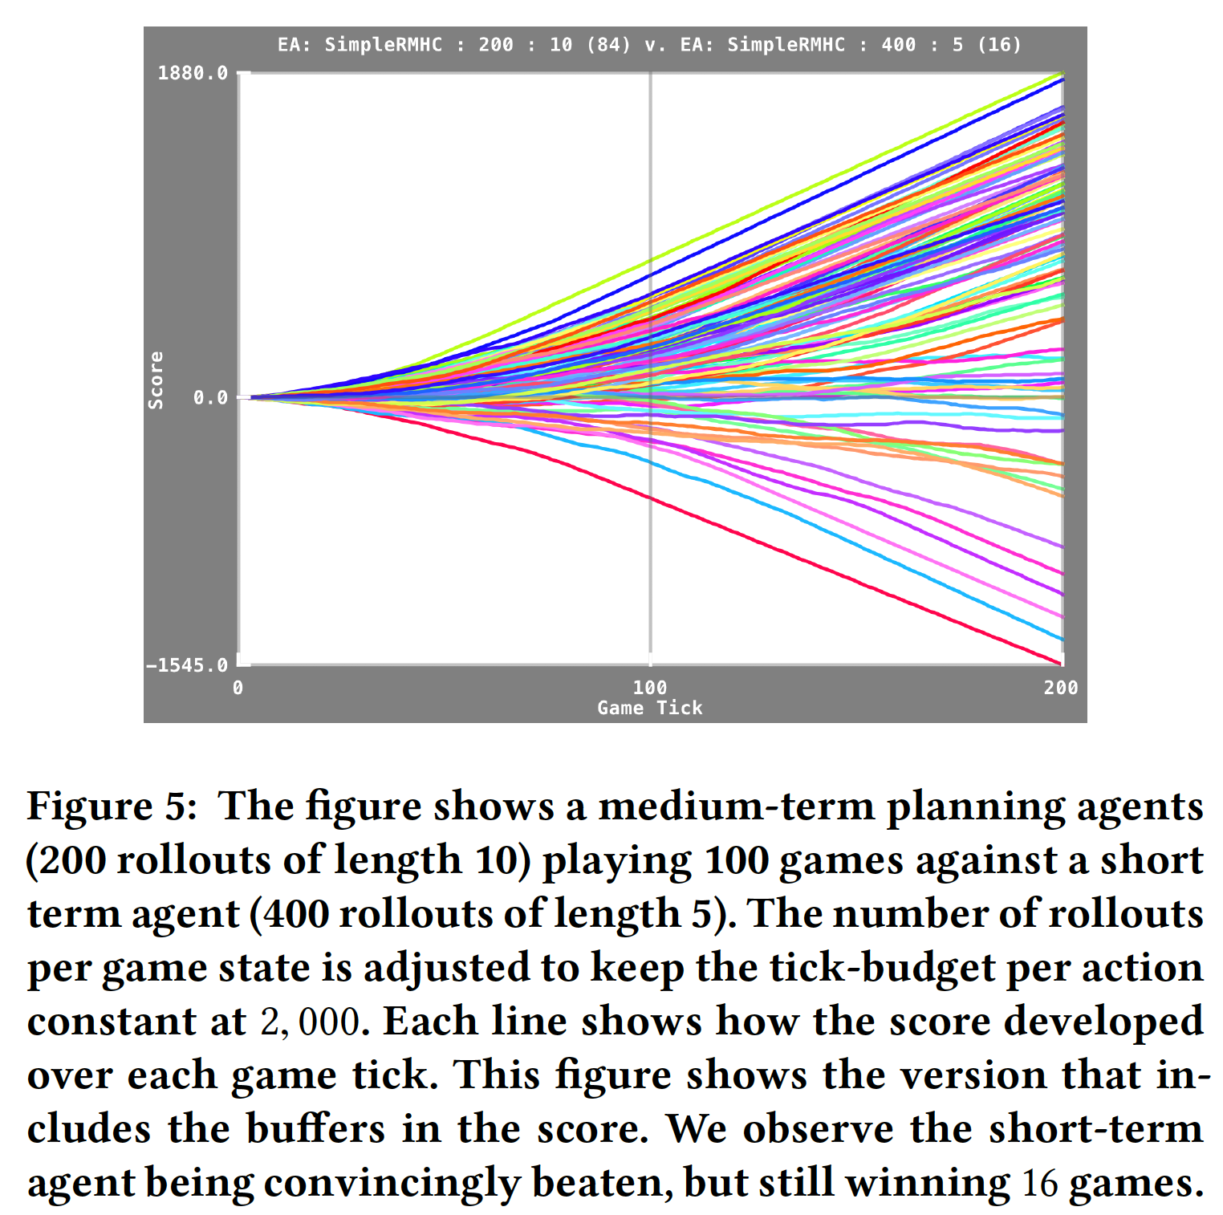
Score versus Game Tick (buffers included)

Slide 32
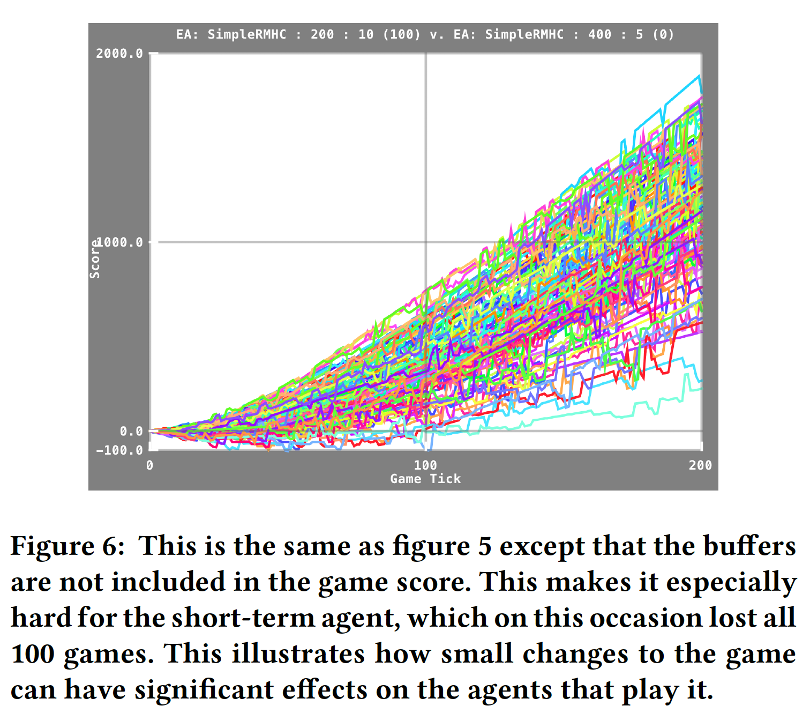
Score versus Game Tick (buffers not included)

Slide 33
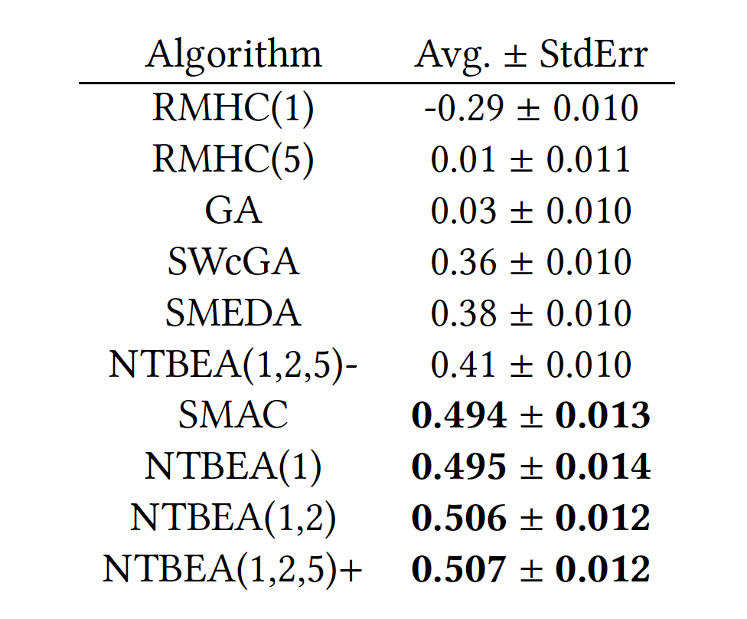
Results of various optimisation algorithms (similar to previous slides)
Model based

Slide 34
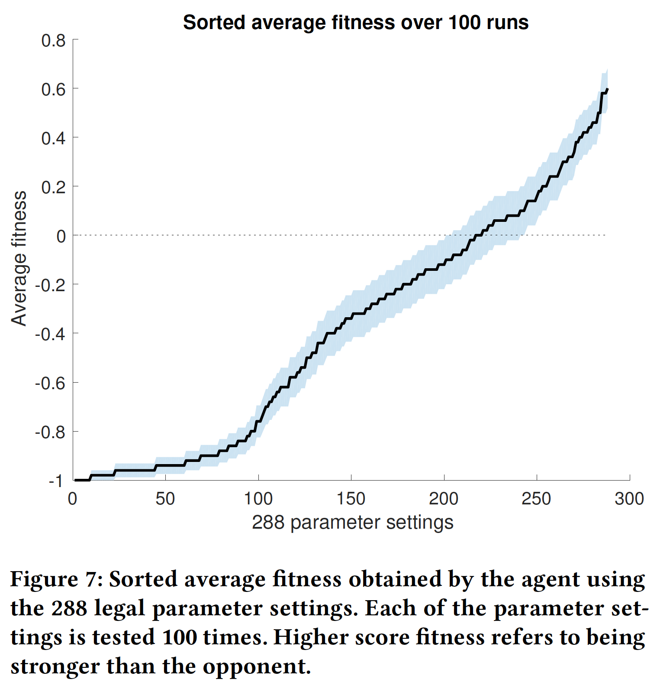
Exploring the Parameter Space Exhaustively What does this say about the game?

Slide 35
So What is New?
We’ve been playing with RHEA for a few years now
But recently:
Have tuned it better
Use long rollouts when needed
Length > 100 may be good
Discount factor where needed
Normally MUCH better to use a shift buffer
Often good to use large mutation strength
Evolutionary algorithm: (1+1) EA gives competitive performance

Slide 36
Dealing with Flat Reward Landscapes
Changing the score function / adding a heuristic
Example: Sokoban – reward each Box in Hole, not just final solution
Enforcing Exploration (State or State/Action Space Measures)
Intrinsic Motivation
Novelty Search
Practical ideas: need a way to measure visits to a state or to similar states
See recent work by DeepMind on Montezuma’s Revenge
Alternative approach:
Bias the rollouts / action sequences

Slide 37
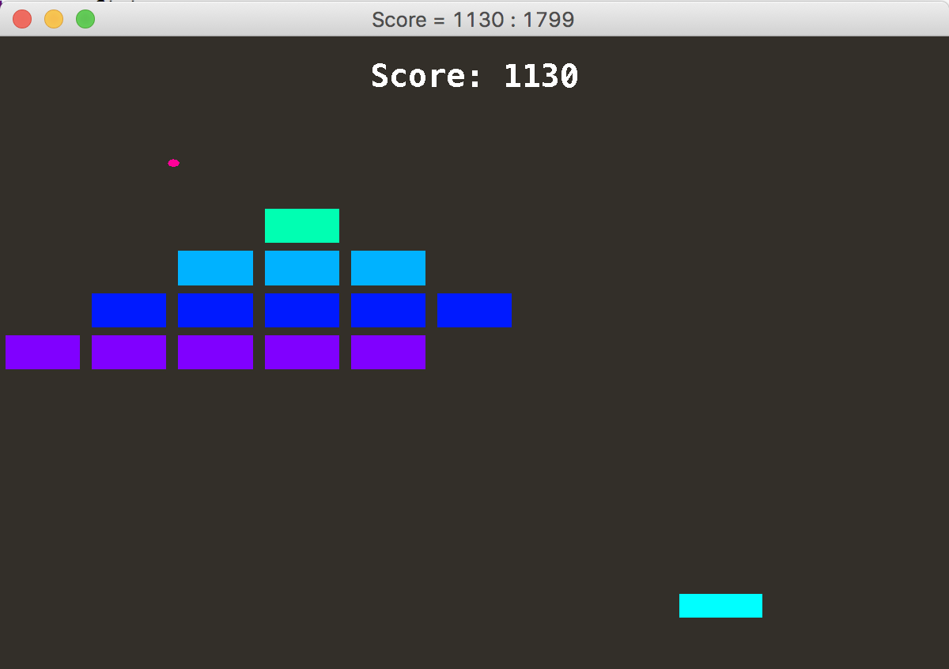
A mutation transducer: repeating previous actions to enable better movement exploration
Without this, SimpleEvoAgent struggles to solve breakout

Slide 38
Mutation Transducer (in KotlinTest repo) May copy previous output value
fun mutate(input: IntArray, range: Int) : IntArray { val output = IntArray(input.size) // now copy across the input for (i in 0 until input.size) { val p = random.nextDouble() if (p < mutProb) { // mutate output[i] = random.nextInt(range) } else if (p < mutProb + repeatProb && i>0) { output[i] = output[i-1] } else { // faithful copy output[i] = input[i] } } return output }

Slide 39
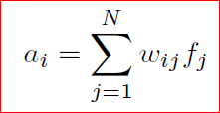
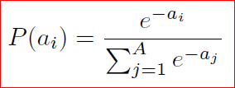
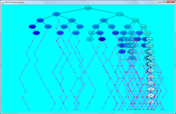
Biasing Roll-Outs (Lucas et al, EvoStar 2014)
Define features to extract from each game state (f vector below)
Aim for simplicity and efficiency
Could be hand-designed or auto-generated
Then sample from Gibbs / Softmax distribution
Learn matrix W
Fast Evo MCTS
S -> F -> P(a)
Fit Vector Source

Slide 40
Mountain Car Example
Car needs to reach top of hill on right
Engine too weak too overcome gravity
Need to oscillate a bit
Vanilla MCTS fails on this!
Why?

Slide 41
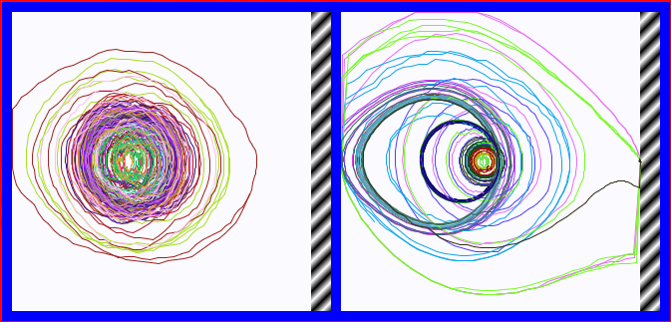
State Space Trajectories (goal is hatched area)
Left: uniform random
Right: biased – features, just the state space
These are random bias vectors: some are worse, but some are much better than uniform

Slide 42
Coping with Long Reward Horizons II
Use Discount Factor
Discount the value of future rewards
Rewards gained further into the future become worth less
View the code in SimpleEvoAgent for this

Slide 43
SFP works amazingly well across a range of games
And plays games well IMMEDIATELY
No need to train for each game
Just needs the FORWARD MODEL (also called World Model, related to Digital Twin)

Slide 44
What about learning a forward model?
Interesting work on this at DeepMind using variational auto-encoders
Also work in our group and Queen Mary
What happens if we deliberately corrupt the model?
we can set false parameter values
and observe the effects

Slide 45
Experimenting with False Game Models
Make the game state parameterized (in a clean way)
All parameters contained in a single GameParams object
Method:
Before passing game state copy to Agent, change one or more of the parameters
Then: true game proceeds as normal
Agent must cope with false model

Slide 46
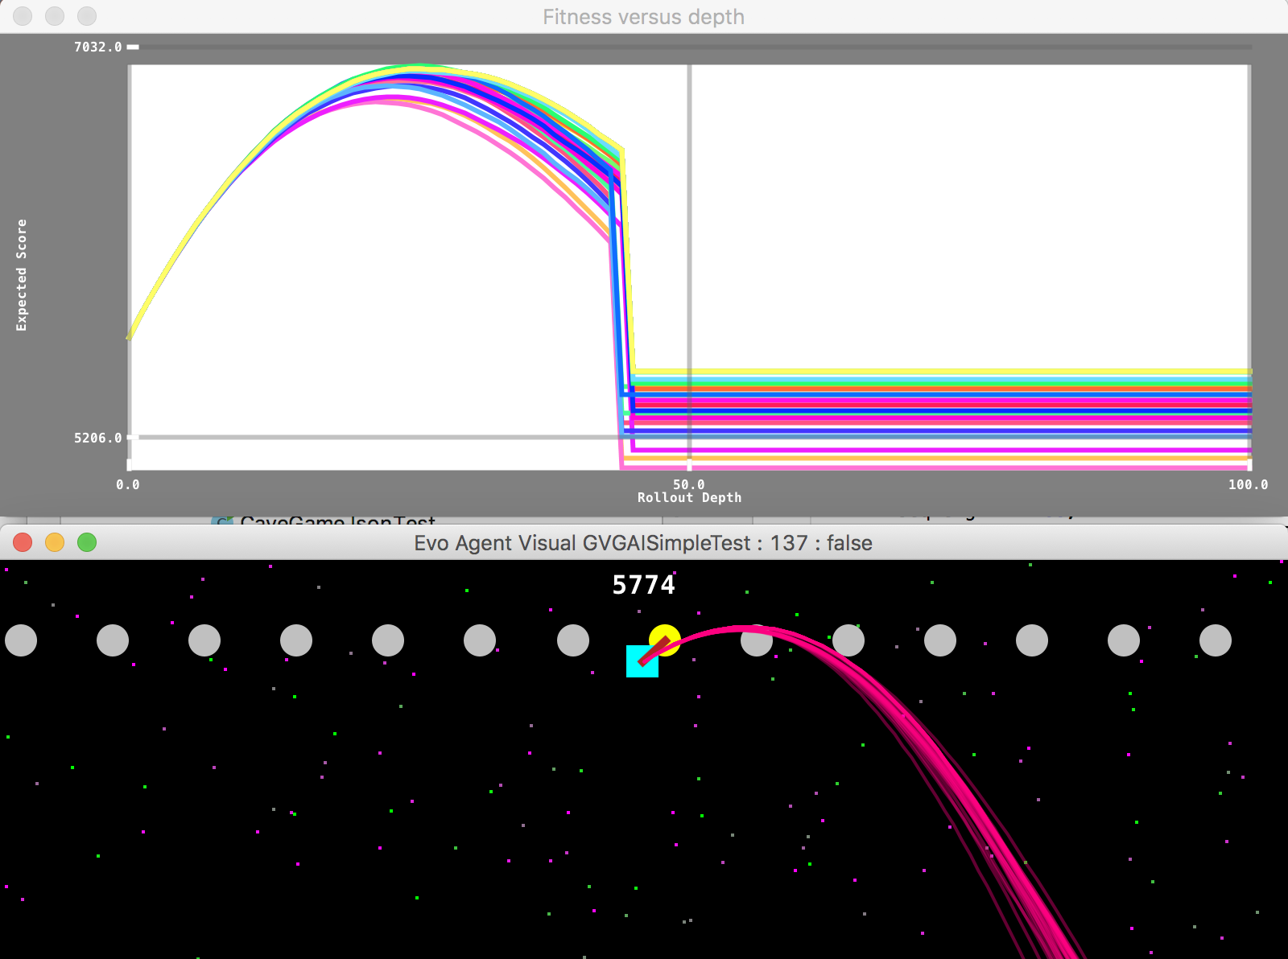
False Models in Cave Swing: Some Surprising Results

Slide 47
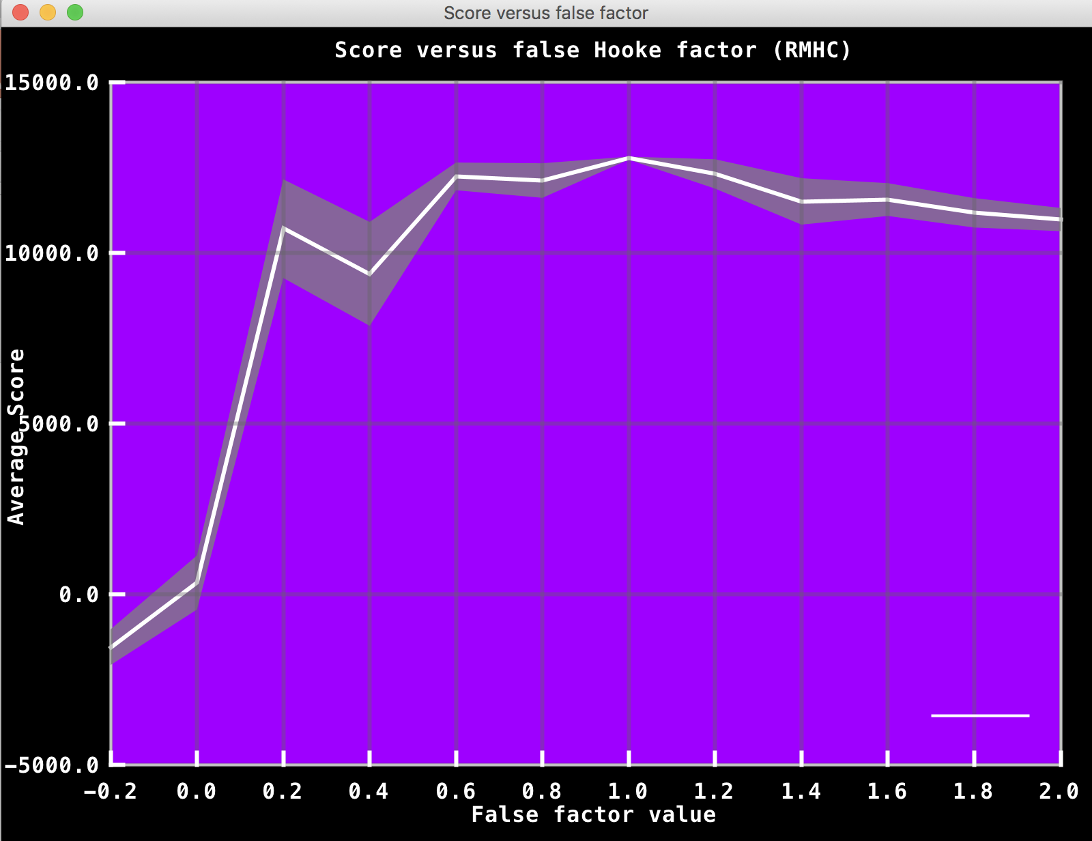
Effects of false factor for Hooke’s constant

